Slide 1
Airline Industry Use-case
(Flight Fare Prediction)
UNDER THE GUIDANCE OF
PROF. JAYA JESWANI
Group Members :
Chandrakant Thakur
Sachin Maurya
Melvin Raju

Slide 2
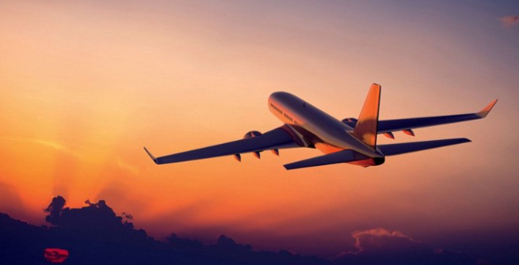
Aim:- Flight Fare Prediction
Description:-
Analysis Data & Extract Meaningful insight from it
Predict the fare of Airlines on different Sources,Destination,Arrival Time,Departure Time,Airline,Total Stops and Additional info etc…

Slide 3
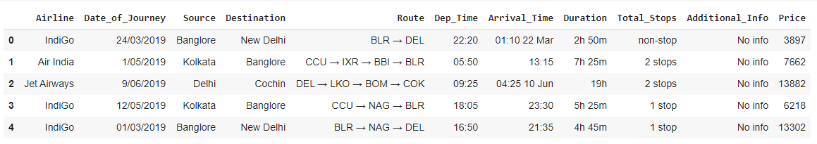
Data Overview
Source : Kaggle and Github
Dataset size: Target Variable: Price
Rows: 10683
Columns: 11

Slide 4
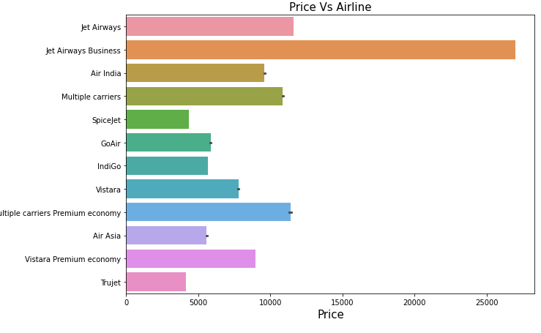
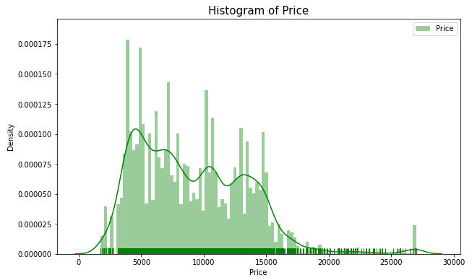
EDA

Slide 5
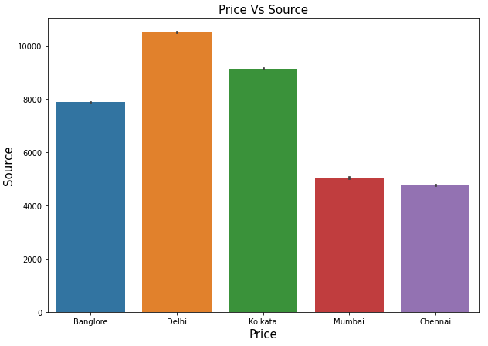
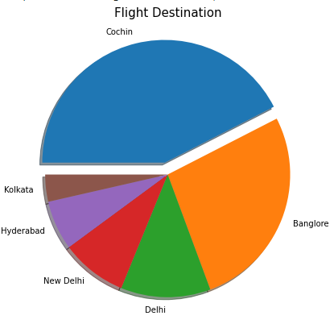

Slide 6
Trained Machine Learning Model
Random Forest(Regression)
Decision Tree(Regression)
Linear Regression(Ridge and Lasso)
Support Vector Machine (Regression SVR)
K Nearest Neighbor (Regression)
Clustering Algorithms:
Partitioning based clustering:-K-means
Hierarchical Clustering:- Agglomerative

Slide 7
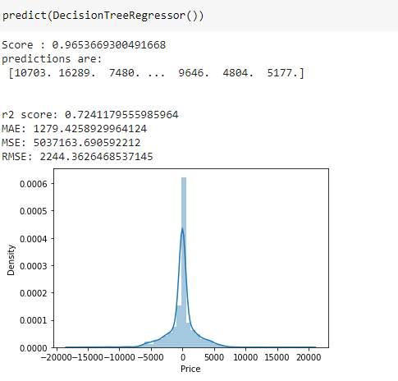
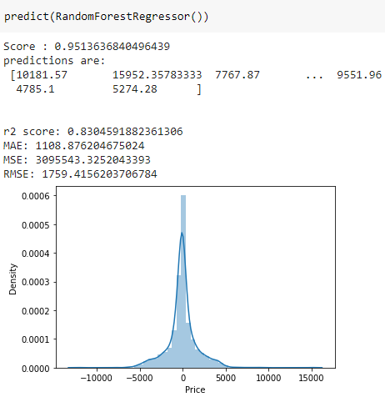
Checking for Score(Result)

Slide 8
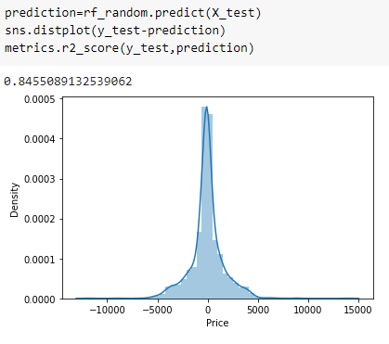
Cross Validation Hypertune our model

Slide 9
Conclusion
After successfully implemented Machine Learning Algorithm we got good Accurecy_score in Random Forest Regression(Accuracy_score 95%) and Decision Tree Regression (Accuracy_score 96%). Using this Accuracy we can deploy our model on cloud with the help of flask API.
Future Scope: we can create website where we can predict flight fare by using different Sources,Destination,Arrival Time,Departure Time,Airline,Total Stops.

Slide 10
References
https://stackabuse.com/hierarchical-clustering-with-python-and-scikit-learn/
https://www.analyticsvidhya.com/blog/2019/08/comprehensive-guide-k-means-clustering/
https://towardsdatascience.com/clustering-with-k-means-1e07a8bfb7ca
https://www.kdnuggets.com
https://www.analyticsvidhya.com/blog/2019/05/beginners-guide-hierarchical-clustering/

